Slide 1
Probiotics and Prebiotics
Introduction

Slide 2
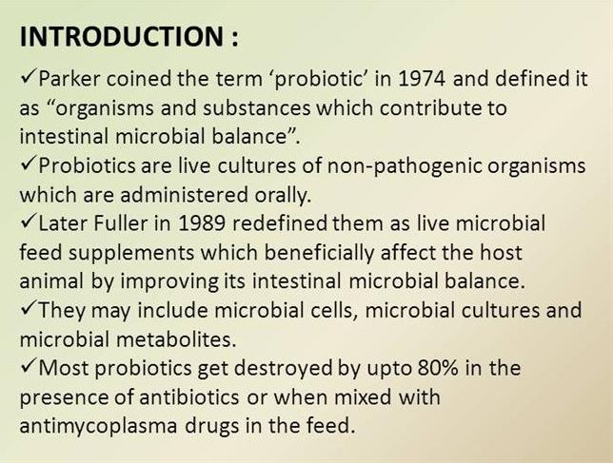

Slide 3
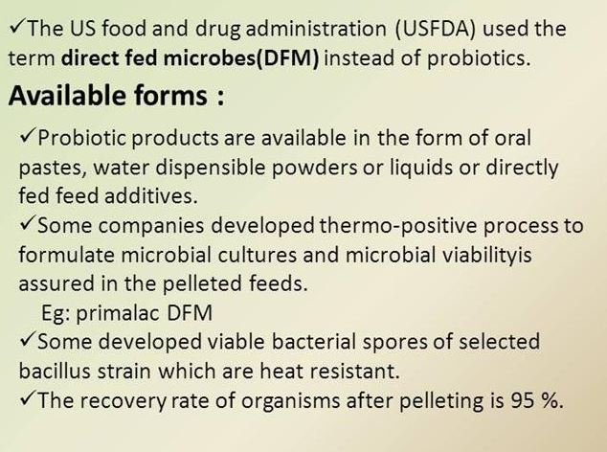

Slide 4
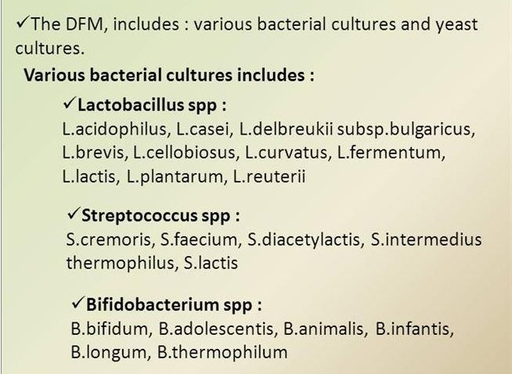

Slide 5
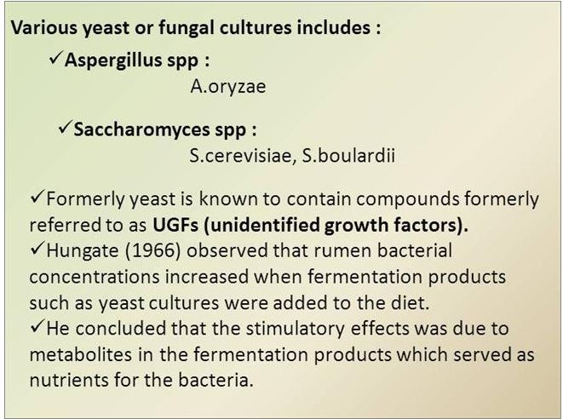

Slide 6
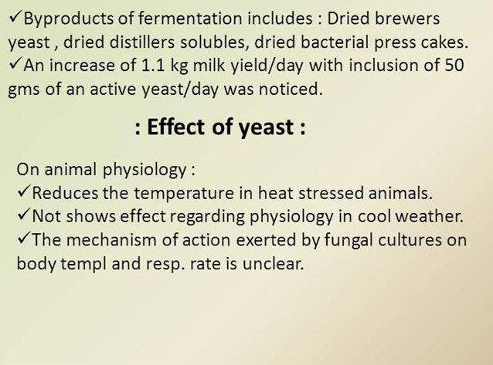

Slide 7
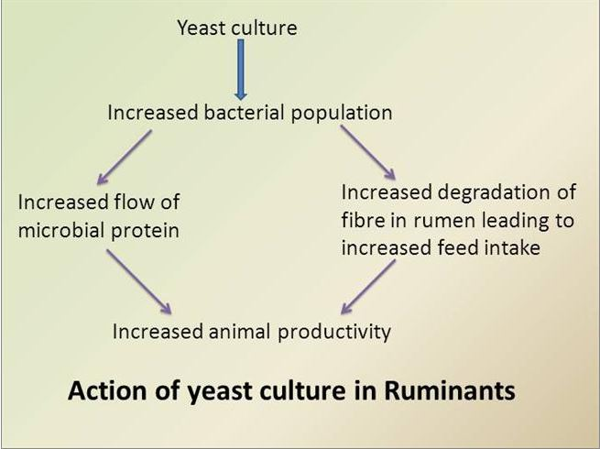

Slide 8
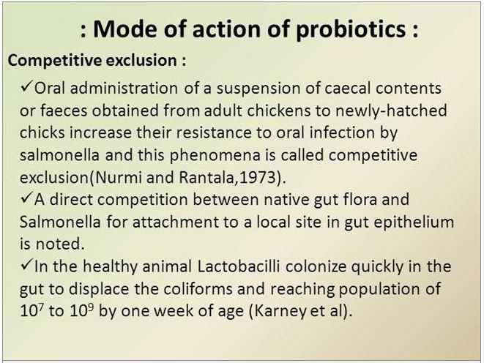
Mode of action of probiotics
1-competitive exclusion

Slide 9
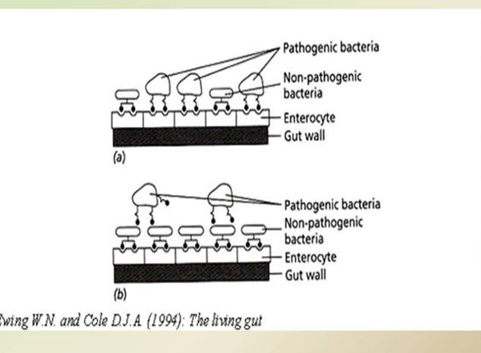

Slide 10
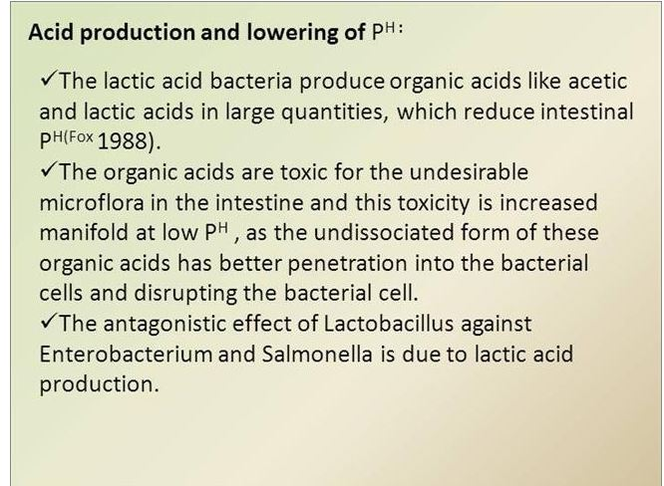
2-Acid production and lowering of pH

Slide 11
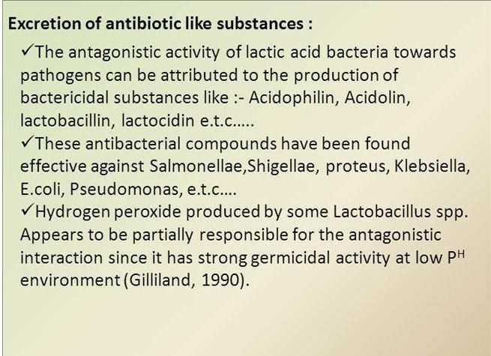
3-Excretion of antibiotic like substances

Slide 12
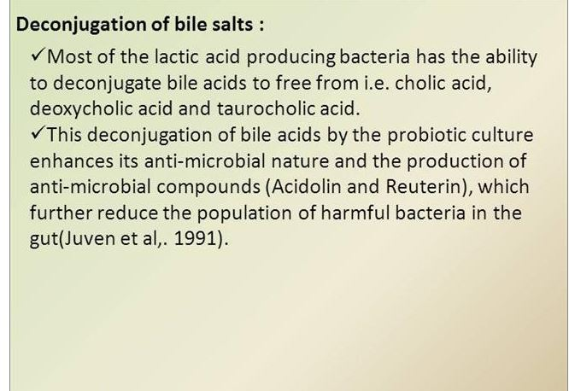
4-Deconjugation of bile salts

Slide 13
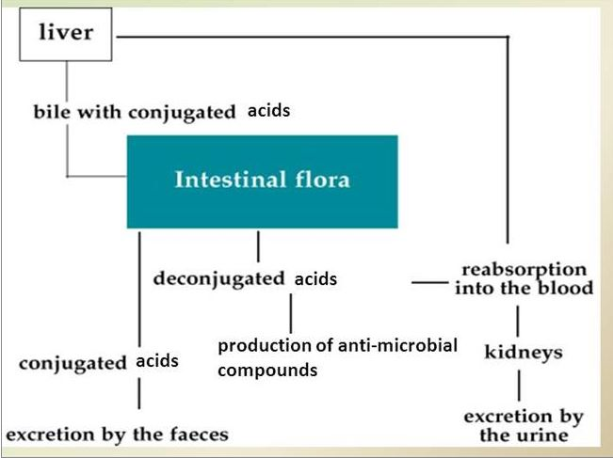

Slide 14
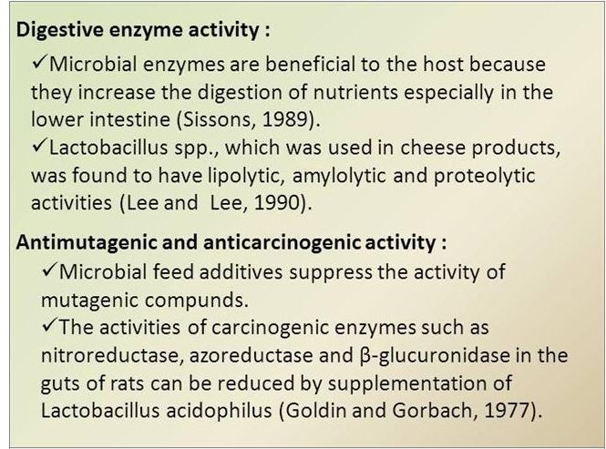
5-Digestive enzyme activity
6-Antimutagenic and anticarcinogenic activity

Slide 15
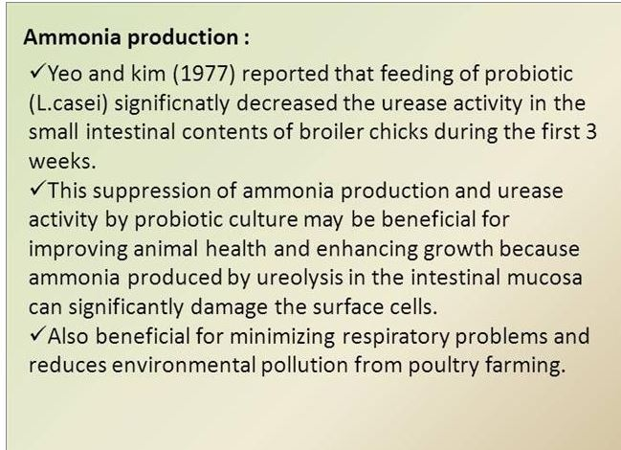
7-Ammonia production

Slide 16
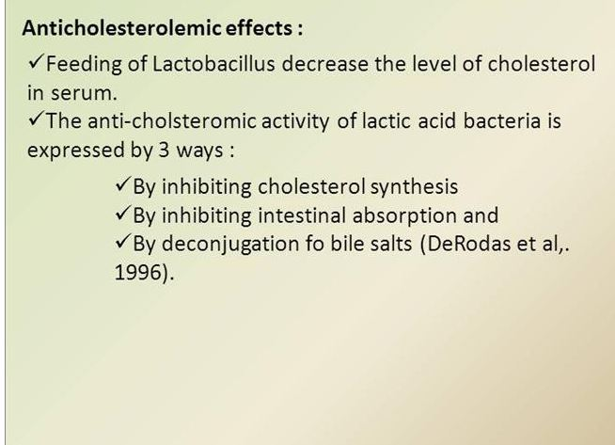
8-Anticholestrolemic effects

Slide 17
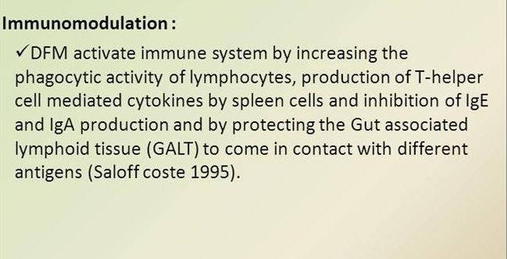
9-Immunomodulation

Slide 18
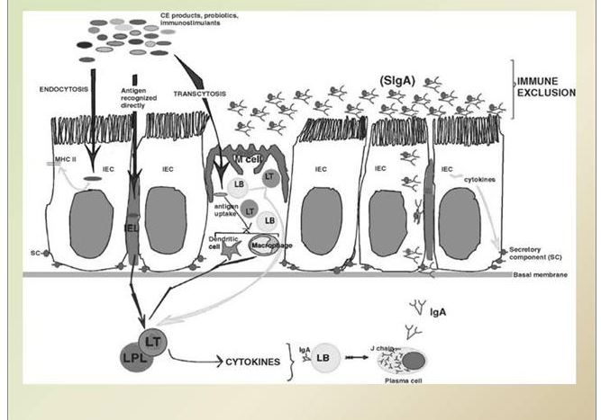

Slide 19
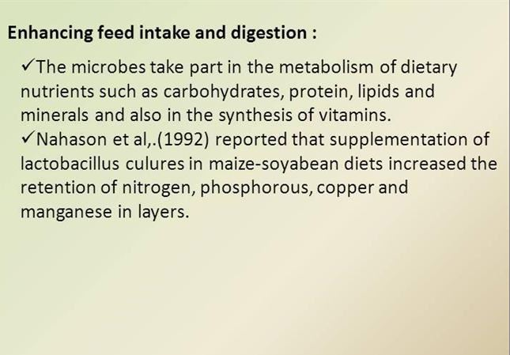
10-Enhancing feed intake and digestion

Slide 20
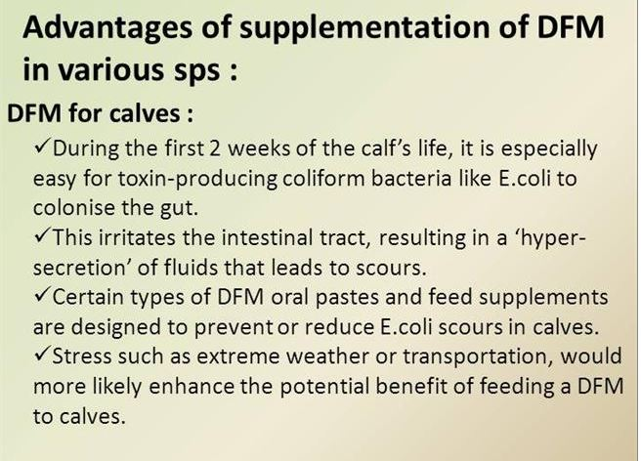

Slide 21
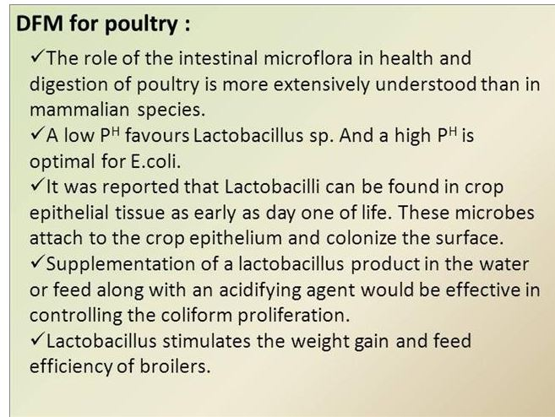

Slide 22
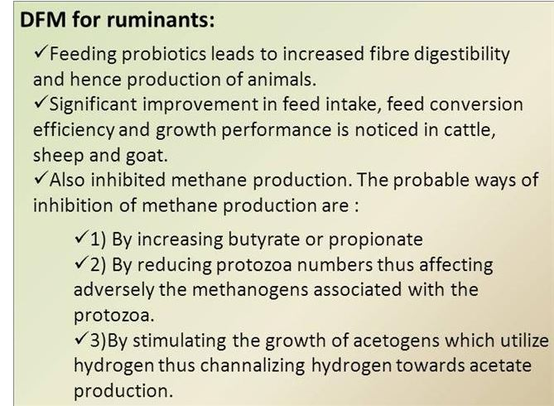

Slide 23
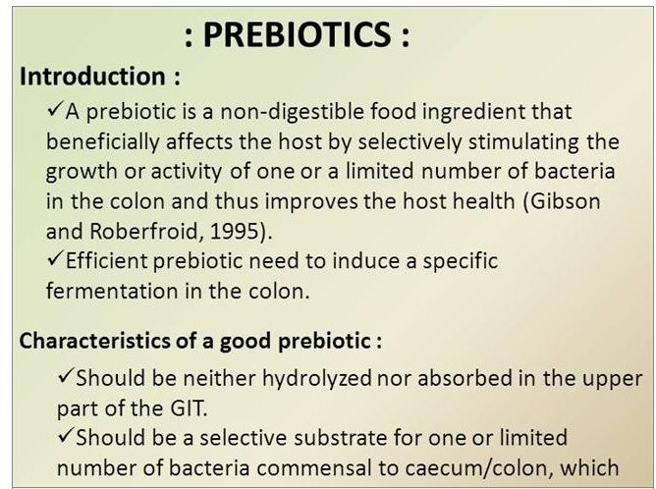

Slide 24
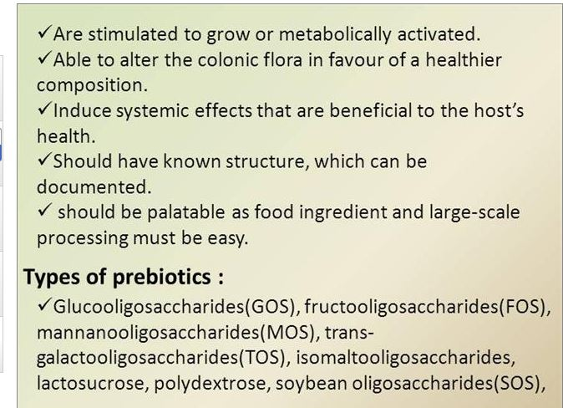

Slide 25
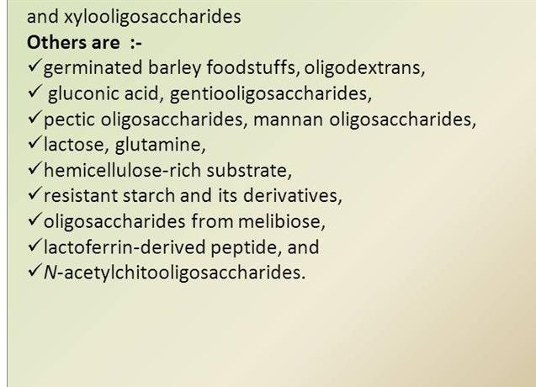

Slide 26
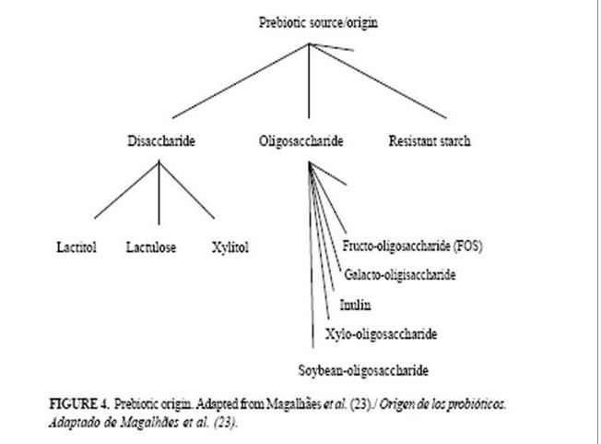

Slide 27
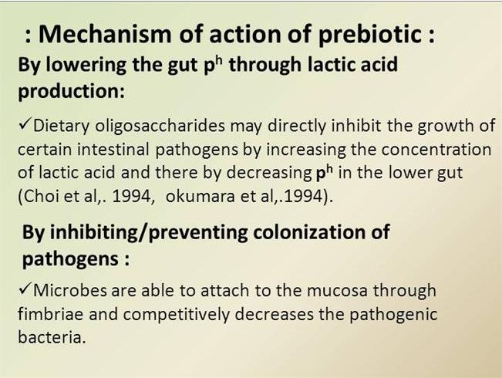

Slide 28
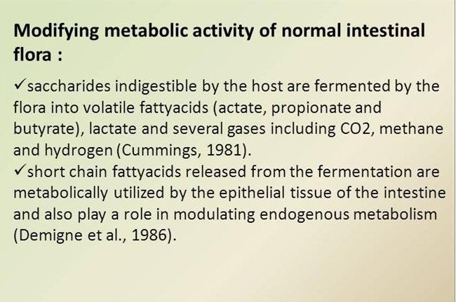

Slide 29
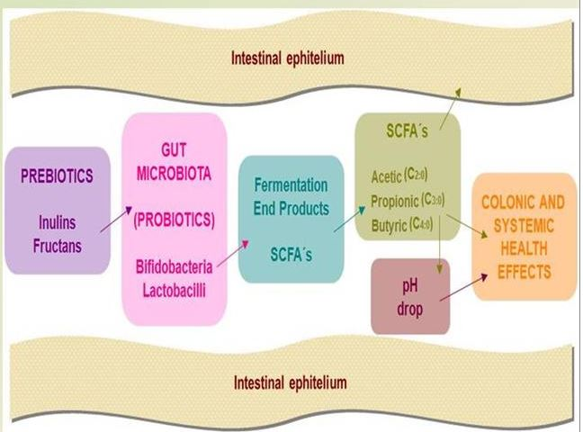

Slide 30
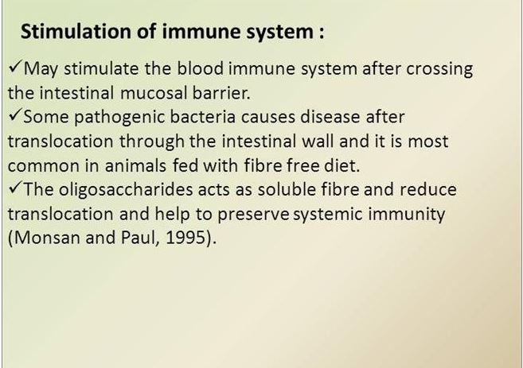

Slide 31
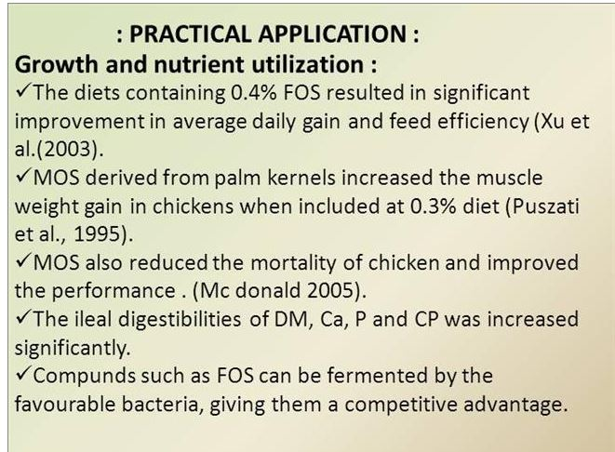

Slide 32
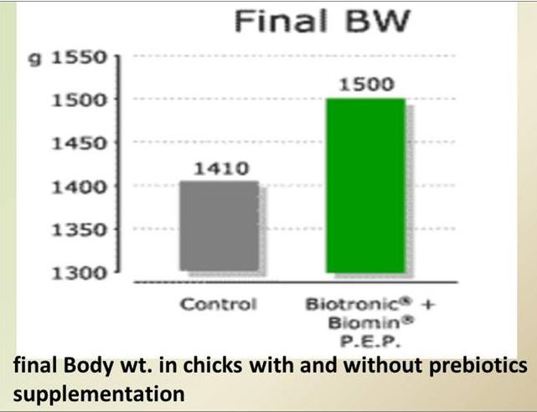

Slide 33
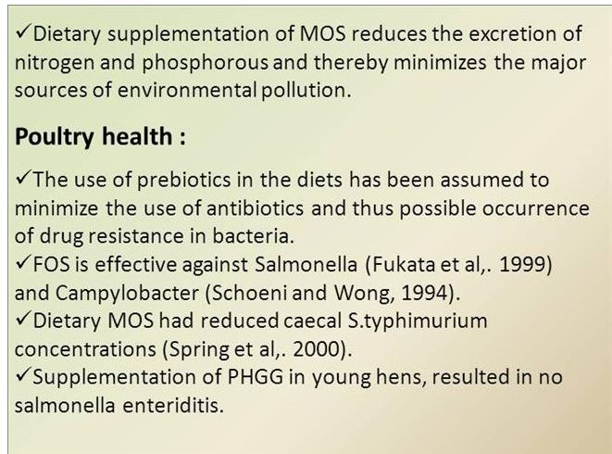

Slide 34
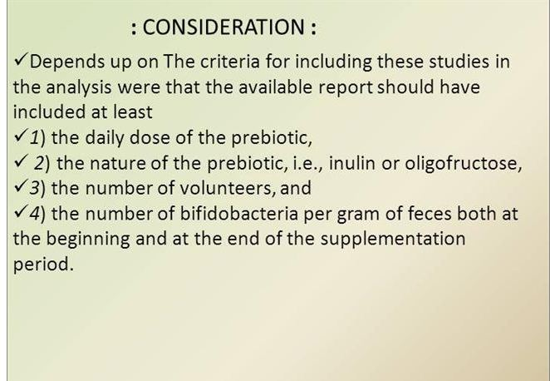

Slide 35
Understanding the definitions
Prebiotic (before life): a substance usually oligosaccharides that cannot be digested but promote the growth of beneficial bacteria or probiotics.
Probiotic (for life): a substance that contains bacteria or microorganism that are beneficial to the life of the host organism.
Symbiotic (Plus life): a substance containing both prebiotic and probiotic.

